Slide 1
No Hold
Structure

Slide 2
Strategy
Description
No Hold
Strategy
End
Point
Strategic
Structure

Slide 3
John 14:30-31
30 I will no longer talk much with you, for the ruler of this world is coming. He has no claim/hold on me, 31 but I do as the Father has commanded me, so that the world may know that I love the Father.

Slide 4
Kingdom of Darkness
Kingdom of Light
Time

Slide 5
Ephesians 4:25-27
25 Therefore each of you must put off falsehood and speak truthfully to his neighbor, for we are all members of one body. 26 "In your anger do not sin": Do not let the sun go down while you are still angry, 27 and do not give the devil a foothold (a place to occupy/live)…

Slide 6
Ephesians 5:17-18
17 Therefore do not be foolish, but understand [put together] what the will of the Lord is. 18 And do not get drunk with wine, for that is debauchery, but be (continually) filled [filled to the rim] with the Spirit…

Slide 7
Strategy
Description
No Hold
Strategy
End
Point
Strategic
Structure

Slide 8
John 14:30-31
30 I will no longer talk much with you, for the ruler of this world is coming. He has no claim/hold on me, 31 but I do as the Father has commanded me, so that the world may know that I love the Father.

Slide 9
A strategy is a general plan of action that is built to accomplish its end point in a specific contest.

Slide 10
The strategic end point describes what will be accomplished.

Slide 11
Strategic pathways, provide direction and support for tactics.

Slide 12
Tactics, are the specific actions that need to be taken in order for a strategy to be successful.

Slide 13
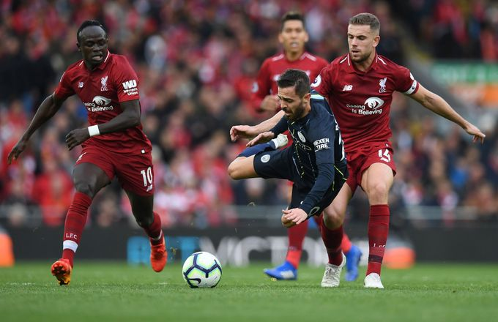

Slide 14
The end point of the No Hold strategy is to attain full spiritual adulthood.

Slide 15
Ephesians 4:11-16
11 And he (Jesus) gave the apostles, the prophets, the evangelists, the pastors and teachers, 12 to equip the saints for the work of ministry, for building up the body of Christ, 13 until we all attain to the unity of the faith and of the knowledge of the Son of God, to mature manhood, to the measure of the stature of the fullness of Christ, 14 so that we may no longer be children, tossed to and fro by the waves and carried about by every wind of doctrine, by human cunning, by craftiness in deceitful schemes. 15 Rather, speaking the truth in love, we are to grow up in every way into him who is the head, into Christ, 16 from whom the whole body, joined and held together by every joint with which it is equipped, when each part is working properly, makes the body grow so that it builds itself up in love.

Slide 16
Ephesians 6:10-13
10 Finally, be strong in the Lord and in the strength of his might. 11 Put on the whole armor of God that you may be able to stand against the schemes of the devil. 12 For we do not wrestle against flesh and blood, but against the rulers, against the authorities, against the cosmic powers over this present darkness, against the spiritual forces of evil in the heavenly places. 13 Therefore take up the whole armor of God that you may be able to withstand in the evil day, and having done all, to stand firm.

Slide 17
…and having done all, to stand firm…
What are you presently doing to stand the way Paul talks about it?

Slide 18
How would you connect Paul’s statement:
“…after you have done everything, to stand firm.” (Eph 6:13)
With Jesus’ statement:
“…. He has no claim/hold [nothing] on me” (John 14:30)?

Slide 19
…He has no claim (hold) on me…
What benefit would there be to you if the devil had “No Hold” on you?

Slide 20
Strategy
Description
No Hold
Strategy
Forgiveness
End
Point
Strategic
Structure
Personal
History
Mind
Renovation

